Slide 1


5th Semester DBMS Mini Project
Psychiatrist Database Management System
PRESENTED BY:
Chethan S 1DB19CS035
GS Sudeep 1DB19CS049
GUIDED BY:
Mrs. Sumathi M
Asst. Professor
Department of CSE
DBIT
GUIDED BY:
Mrs. Rakheeba Taseen
Asst. Professor
Department of CSE
DBIT
Department of Computer Science and Engineering
Don Bosco Institute of Technology, Mysore road, Kumbalagodu,Bangalore

Slide 2
AGENDA
INTRODUCTION
ABSTRACT
AIM AND OBJECTIVE
SYSTEM ARCHITECTURE DIAGRAM
TABLE LIST
ER DIAGRAM
SCHEMA DIAGRAM
CONCLUSION
REFERENCE

Slide 3
Introduction
In the current world where every application finds a place in the online platform, Psychiatry Hospital System would be one of them.
A psychiatry hospital system includes several functionalities such as maintaining patient records, Doctor records, availability of doctors, appointments with doctors or medication prescribed for patients.
Understanding these fundamental functionalities helps one to understand how hospital system works and helps to build modern trends in online hospital systems.
Keeping in mind the functionalities and the need of present generation we have developed a database management system for psychiatry hospital/department for the patients and doctors working in the hospital.
It involves the database that hospital maintains for all doctors and patient’s functionality. It keeps the day-by-day records of patients and doctors involving information of patient appointments with doctors, patient profiles and doctor profiles.
It removes the need of physical movement to a bank to carry out basic services offered at a hospital.

Slide 4
Abstract
Psychiatrist Database Management System provides the benefits of streamlined operations, enhanced administration & control, superior patient care, strict cost control and improved profitability.
PDMS is powerful, flexible, and easy to use and is designed and developed to deliver real conceivable benefits to patients and doctors. More importantly it is backed by reliable and dependable support.
The project ‘Psychiatrist Database Management System’ is based on the database, object oriented and networking techniques. As there are many areas where we keep the records in database for which we are using MY SQL software which is one of the best and the easiest software to keep our information. This project uses HTML and CSS as the front-end software has connectivity with MY SQL.
Psychiatrist Database Management System is custom built to meet the specific requirement of the mid and large size hospitals across the globe. All the required modules and features have been particularly built to just fit in to your requirement.
Not stopping only to this but they are highly satisfied and appreciating. Entire application is web based and built on 3 tier architecture using the latest technologies. The sound database of the application makes it more users friendly and expandable. The package is highly customizable and can be modified as per the needs and requirements of our clients.

Slide 5
Aim and Objective
Aim:-
1. Specifying the Application and various components of the Architecture.
2. Specifying the bindings between the tasks and the resources either manually or by the design
Tools.
3. Specifying the port interconnections between the resources.
Objective:-
1) Convenience
2) Types of doctors
3) Availability of doctors
4) Crowd control

Slide 6
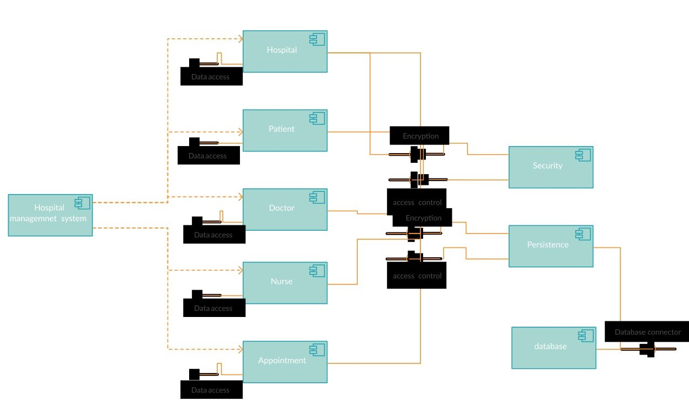
SYSTEM ARCHITECTURE DIAGRAM

Slide 7
TABLE LIST
Doctors (did, email, doctor name, dept)
Patients(pid, email, name, gender, dept, number, date, time, slot, disease)
Test(id, name, email)
Feedback(pid, did email, feedback)
User(id, username, usertype, email, password)

Slide 8
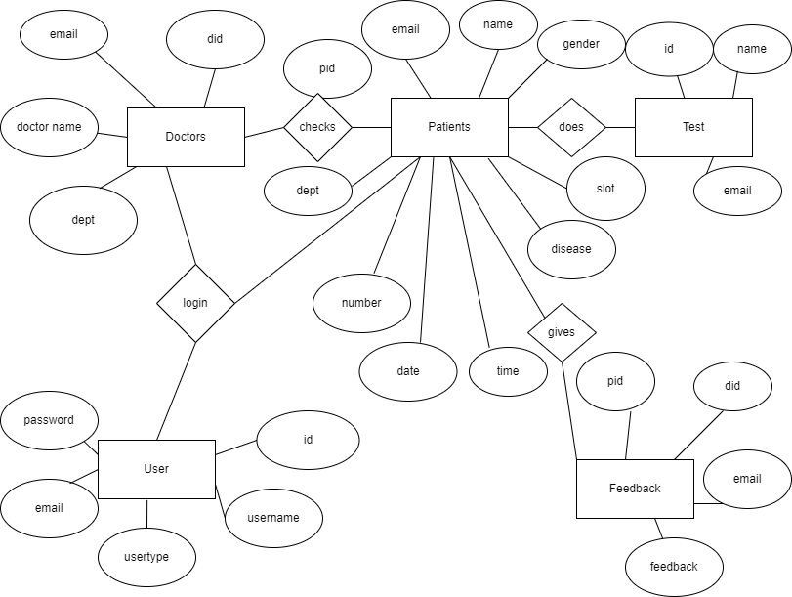
ER DIAGRAM

Slide 9
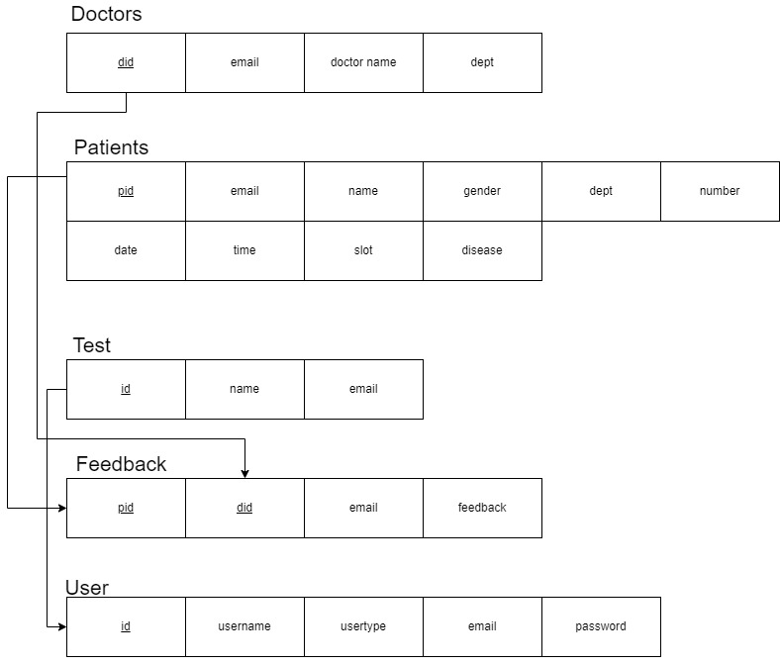
SCHEMA DIAGRAM

Slide 10
CONCLUSION
Thus we have successfully implemented online psychiatry database management system which helps patients and doctors of the hospital to easily book and view appointments without being physically present in hospital.
We have successfully implemented various functionalities of database and python and created fully functional database management system for psychiatry management system.

Slide 11
Reference
Ramez Elmasri, Shamikant B. Navathe; Fundamentals of Database Management Systems; 5th Edition; Pearson; 2017
Raghuramakrishnan, and Gehrke; Database Management Systems; 3rd edition; McGraw Hill; 2014
https://www.w3schools.com/sql/default.asp
https://www.youtube.com/CodeWithHarry/
https://www.w3schools.com/css/default.asp

Slide 12
Thank You

